Slide 1


Software Requirements Specifications
Presented by

Slide 2
Introduction
Purpose - This Software Requirements Specification (SRS) document defines the software requirements for Studious, a study-themed web application designed to enhance productivity and collaboration for students and self-learners. This document specifies all functional and non-functional requirements for the Studious v1.0 release. It focuses on the web application portion of the system. Any unrelated components, such as mobile versions, End-to-end encryption, and AI implementation, are excluded.
Document Conventions – Headings, Bold Text, “Must” statements, and priorities explicitly stated for each major requirement and are not inherited by default
Intended Audience – Developers to understand system architecture/implement features, Project Managers to plan and manage deliverables and milestones, testers to develop test cases, and stakeholders to validate that the platform aligns with academic goals.
Notes:
Who we are, what our goal is, blah blah

Slide 3
Introduction
4. Product Scope: The scope for Studious defines the boundaries, objectives, and key use cases for the application, focusing on its academic and collaborative features. For a detailed review of the scope of our application please refer to our Scope and Vision Document located in the GitHub.
5. References:
* IEEE Std. 830-1998: IEEE Recommended Practice for Software Requirements Specifications
*W3C Web Standards Documentation - https://www.w3.org/TR/html52/
*MDN Web Docs - https://developer.mozilla.org/
*React Developer Documentation - https://react.dev/
*Node.js Official Documentation - https://nodejs.org/
*PostgreSQL Documentation - https://www.postgresql.org/docs/
*Scope and Vision Document - https://github.com/hudcho/Studious/

Slide 4
Overview
Product Perspective: Studious will be deployed using modern web technologies, including:
Frontend: React (with Tailwind CSS for UI styling)
Backend: Node.js and Express
Database: PostgreSQL
Real-Time Communication: Socket.io
Deployment: Frontend hosted on Vercel, Backend hosted on Render
Notes:
Brief description of product we are creating and what core features we want it to do, bulleetted lists not sentences or pargaphs

Slide 5
Overview
2. Product Functions: Study Circles, Direct Messaging, User Profiles, Note Sharing & Requesting, Calendar & Assignment Tracking, Pomodoro Timer, and Interactive Study Tools.
3. User Classes and Characteristics: Depicted on the left
4. Operating Environment: Supporting Environments include:
Operating Systems: Windows 10+, macOS 12+, Linux (Ubuntu 20.04+)
Browsers: Chrome (v110+), Edge (v110+), Firefox (v100+), Safari (v15+)
Internet Connection: Required for messaging, data storage, and collaboration.
User Class | Description | Technical Expertise | Frequency of Use
Students: | Primary users who collaborate in study circles and track study progress. | Basic–Moderate | Daily
Educators/Tutors: | Create or oversee group study sessions. | Moderate | Weekly
Administrators: | Manage user accounts, data integrity, and system maintenance. | Advanced | As needed

Slide 6
Overview
5. Design & Implementation Constraints:
Must be implemented using React, Node.js, Express, and PostgreSQL.
Must use Socket.io for real-time study circle and messaging functionality.
Must follow GDPR and FERPA compliance for data security.
Must use HTTPS for secure client-server communication.
Must ensure page load and response times within 3 seconds under normal load.
Must be designed for scalability to support future cloud migration.
6. User Documentation: User Manual, Quick Start Guide, and FAQ Page, and Developer Documentation(Internal)
7. Assumption and Dependencies:
Assumptions:
Users have reliable internet access and a modern browser.
Users are familiar with basic online collaboration tools.
Students and tutors will actively engage with the app’s productivity and communication features.
Dependencies:
Node.js and Express for backend logic.
PostgreSQL for database management.
Socket.io for real-time communication.
Vercel (frontend) and Render (backend) for hosting and deployment.

Slide 7
External Interface
Request # | Feature | External Interface Sentence | Priority
EIR#1 | User Interface | The system must run on a web browser via desktop and tablet interfaces. | High
EIR#2 | Hardware | The system must operate without the use of specialized hardware. | High
EIR#3 | Software | The system must utilize a React based frontend hosted on Vercel. | Medium
EIR#4 | Security | The system must utilize JSON Web Tokens to support secure authentication and session management. | High
EIR#5 | Communication | The system must allow real-time communication using Socket.io services. | High
Notes:
Sketch of UI, show what we want it to look like

Slide 8
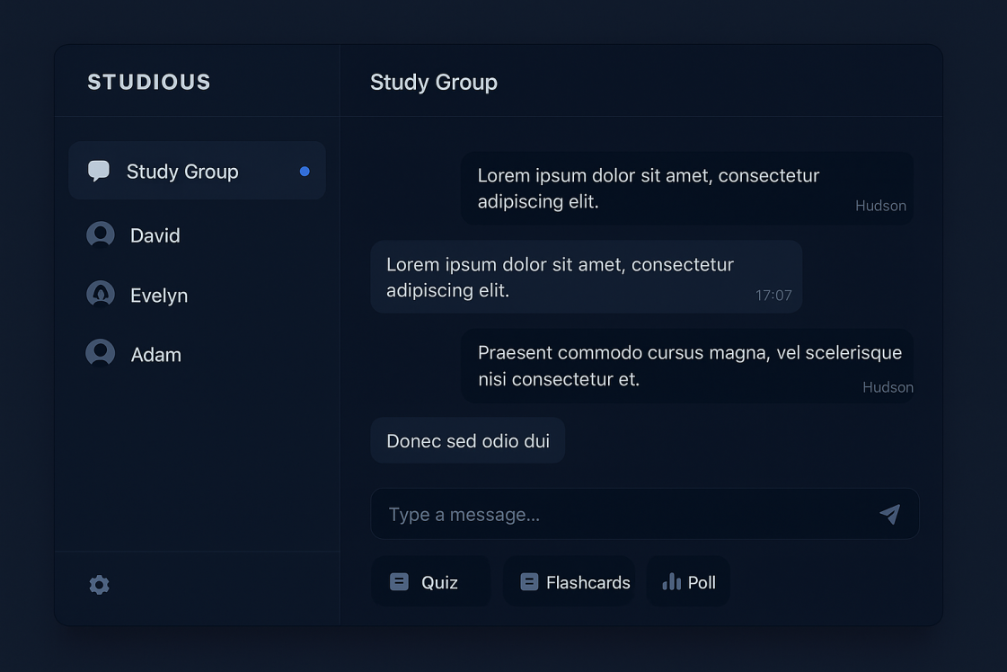
External Interface
To the left is an example of the interface we plan to implement. Here is the messaging page, where users can message other individual users or complete groups. You can view your message history, create quizzes, flashcards and polls with each messaging subpage, as well.
Notes:
Sketch of UI, show what we want it to look like

Slide 9



Functional Requirements
Profile management
Communication
Search
Social networking
Assignment tracking
Study tools
Notes:
Sketch of UI, show what we want it to look like

Slide 10


Functional Requirements cont.
File sharing
Administrative tools
System requirements
Data storage
Security
Notes:
Sketch of UI, show what we want it to look like

Slide 11
Nonfunctional Requirements
Performance
Security
Usability
Compatibility
Privacy
Scalability
Notes:
Sketch of UI, show what we want it to look like

Slide 12
Other Requirements
Notes:
Sketch of UI, show what we want it to look like

Slide 13
User stories
As a | I need the system to | So that I may
Off-Campus College Student | Load and function in a reliable timeframe to access resources | Access my study resources without losing focus or motivation.
Mobile User | Sync my data securely across all devices | Ensure my progress is safely backed up while using the software away from the computer.
College Student in a Study Group | Keep online study rooms stable and responsive, even when multiple users are connected | Work efficiently with my peers without interruptions or lag.
Notes:
Sketch of UI, show what we want it to look like

